Slide 1
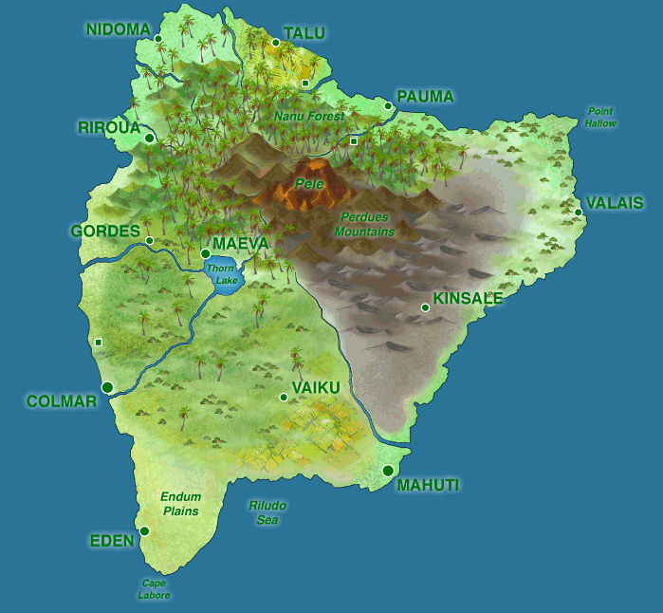
Life on an Island: Using a Virtual World to Make Statistics Real
Ann M. Brearley and Laura J. Le
Division of Biostatistics
University of Minnesota
Stat Chat
Materials Potluck
March 27, 2019

Slide 2
GAISE College Report Recommendations
Teach statistical thinking.
Teach statistics as an investigative process of problem-solving and decision-making.
Give students experience with multivariable thinking.
Integrate real data with a context and purpose.
Foster active learning.
Use technology to explore concepts and analyze data.
Notes:
1, 3 and 4 often approached using individual or group projects. Projects relevant to medical and public health professionals are difficult to come by.
5 technology (Islands) allows students to design and carry out a real-seeming clinical trial or observational study of their own without running afoul of IRB’s.

Slide 3
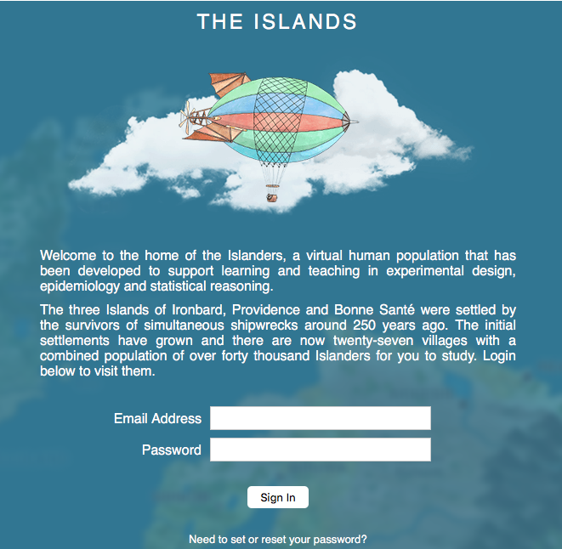
Islands Exploration Activity
Time to put on your student hat!
“Fly” to the Islands via:
theislands.umn.edu

Slide 4
Islands Exploration Wrap-Up
Share what you found interesting about the Islanders or Islands.
Notes:
Interesting: Q9, 10, 11

Slide 5
Examples of Teaching with the Islands

Slide 6


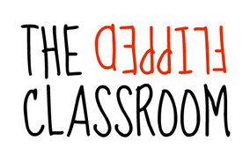
Biostatistical Literacy PubH 6414 (UMN)
Class Format:
Pedagogical Approach
In-person Online
&
Class Size:
Student Background
80
20
Public Health graduate students
Physicians
Dentists
Nurses
Veterinarians
Pharmacists
to
Students

Slide 7
Islands Project Overview
Students work in groups to design, conduct, and analyze results of a study using the Islands.
Groups of ~2 to 6 students.
TAs serve as statistical consultants.
Students present their findings in a poster session at the end of the course.
Guidelines for reporting used:
CONSORT (RCTs)
STROBE (observational studies)
Notes:
The Island(s) project was first used in Biostatistics in PubH 6414, in Fall 2012, online and in-person.

Slide 8
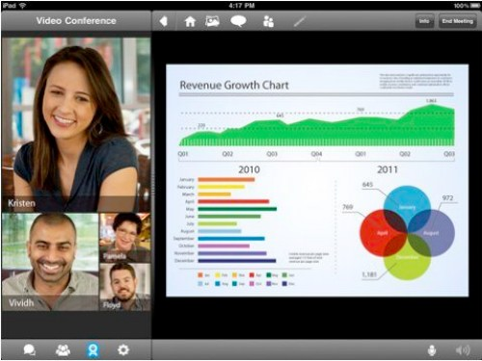


Collaborating Online
Groups collaborate using various tools:
Google Hangouts, Skype, FaceTime, etc.
Google Drive, DropBox
Moodle chat rooms
Phone, Text, Email
Works best if groups meet weekly (e.g., in-person lab)
Notes:
Images (top to bottom) from FaceTime, Google Hangouts, and Skype websites.

Slide 9


Island Study Project Examples
Effects of Methamphetamine on Cognitive Function in Young Adults
RE-WINE: The Effect of Red Wine on Serotonin Release
YIKES! Youth Islander Knowledge Enhancement Study [Effect of Dextroamphetamine on Arithmetic Performance]
Effects of Smoking on Pulmonary Functioning and Exercise Tolerance
The DREAM Study: The Effect of Different Exercise Assignments on Melatonin
Notes:
Images are from Fall 2013 PubH 6414 Online student projects
Mention benefits briefly here; more detail later.

Slide 10

Biostatistics I & II PubH 6450 & 6451 (UMN)
Class Format:
Pedagogical Approach
In-person Online
&
Class Size:
Student Background
150
25
Nurses
Veterinarians
Pharmacists
to
Students
Public Health graduate students
Physicians
Notes:
Difference: Students analyze their own data. TA gives advice only.

Slide 11
Introduction to Clinical Trials PubH 3415/7415 (UMN)
Class Format:
Online
Class Size:
Student Background
35
Undergraduates
Public Health Minors
Graduate Students
Public Health and Health Care professionals
Students
Notes:
Undergrads: Islands project
Grad students: Protocol project
Students write a complete study protocol

Slide 12
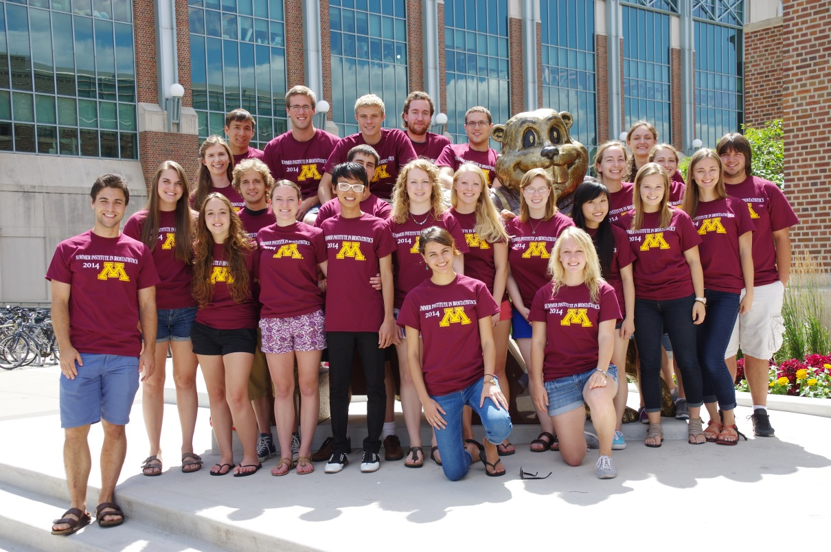
Summer Institute in Biostatistics (SIBS)
Six-week full-time in-person summer program
SAS or R software
25 students, 2 TAs, 2 instructors
Undergraduates, mostly juniors, potentially interested in careers in biostatistics
Notes:
Completed in much shorter time period, about three weeks.
More complex, ambitious projects: Observational studies, genomic studies, spatial statistics studies, epidemiologic studies, repeated measures, cross-over designs, factorial designs.

Slide 13
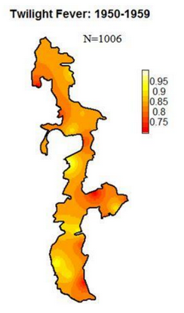
SIBS Island Projects
Genetic Analysis of Summer's Pain (GASP)
Comprehensive Analysis of Twilight Fever in Island Towns (CATFIT)
Physical Ability from Coffee and Energy Drinks (PACED)
Study and Analysis of Depression on Classical-Music Efficacy and Needle-Injected Serotonin (SAD OCEANS)
Notes:
The projects are from Summer 2014.
Genetic Analysis of Summer's Pain (GASP) -- genetics
Comprehensive Analysis of Twilight Fever in Island Towns (CATFIT) –spatial (map: proportion of all deaths due to Twilight Fever, by village)
Physical Ability from Coffee and Energy Drinks (PACED) – cross-over
Study and Analysis of Depression on Classical-Music Efficacy and Needle-Injected Serotonin (SAD OCEANS) – two-way factorial
Others:
Can Altering Student’s Testing Actions Work Across Youth (CASTAWAY) –repeated measures, mixed models
Analysis of the Short Term Effects of Caffeine on Hunger (ASTECH) -- crossover

Slide 14

Questions?

Slide 15
Handouts…
The materials from this Materials Potluck can be can be found in this Google Drive folder:
https://tinyurl.com/StatChat-IslandProject
Contents:
These slides
The Islands Exploration Activity worksheet
An Overview of the Islands Project
Notes:
TINY URL!
https://drive.google.com/drive/folders/1aOBec46xLNe0JLym4SYxuFpSkXAbPGp6?usp=sharing

Slide 16
References
American Statistical Association (2016). Guidelines for assessment and instruction in statistics education (GAISE) college report 2016. The American Statistical Association (ASA). Retrieved November 23, 2016 from http://www.amstat.org/asa/files/pdfs/GAISE/GaiseCollege_Full.pdf.
Bulmer, M., & Haladyn, J.K. (2011). Life on an Island.: A simulated population to support student projects in statistics. Technology Innovations in Statistics Education, 5(1).
Schulz, K.F., Altman, D.G., & Moher, D, for the CONSORT Group (2010). CONSORT 2010 Statement: Updated Guidelines for Reporting Parallel Group Randomised Trials. PLoS Med, 7(3): e1000251.
von Elm, E., Altman, D.G., Egger, M., Pocock, S.J., Gøtzsche, P.C., Vandenbroucke, J.P., et al. (2007). The Strengthening the Reporting of Observational Studies in Epidemiology (STROBE) Statement: Guidelines for Reporting Observational Studies. PLoS Med, 4(10): e296.

